Slide 1
Topic - 08

Slide 2
ToC
Client-Server Architecture
REST Architecture
Web Framework
Flask
Flask simple API
Flask SQLAlchemy
FbReplica project

Slide 3
Client-Server Architecture

Slide 4

Client-Server Model
The client–server model is a distributed application structure that partitions tasks or workloads between the providers of a resource or service, called servers, and service requesters, called clients.

Slide 5
Client-Server Model - Example
When a bank customer accesses online banking services with a web browser (the client), the client initiates a request to the bank's web server.
The customer's login credentials may be stored in a database, and the web server accesses the database server as a client. An application server interprets the returned data by applying the bank's business logic, and provides the output to the web server. Finally, the web server returns the result to the client web browser for display.

Slide 6
Client-Server Model - Example
In each step of this sequence of client–server message exchanges, a computer processes a request and returns data. This is the request-response messaging pattern. When all the requests are met, the sequence is complete and the web browser presents the data to the customer.
This example illustrates a design pattern applicable to the client–server model.

Slide 7
REST Architecture

Slide 8
REST Architecture
Representational State Transfer (REST) is an architectural style that defines a set of constraints and properties based on HTTP.
Web Services that conform to the REST architectural style, or RESTful web services, provide interoperability between computer systems on the Internet.
Notes:
https://en.m.wikipedia.org/wiki/Representational_state_transfer

Slide 9
REST Architecture
REST-compliant web services allow the requesting systems to access and manipulate textual representations of web resources by using a uniform and predefined set of stateless operations.
Other kinds of web services, such as SOAP web services, expose their own arbitrary sets of operations.
Six guiding constraints define a RESTful system.
Notes:
https://en.m.wikipedia.org/wiki/Representational_state_transfer

Slide 10
Six Constraints
The six constraints are:
Uniform Interface
Stateless
Cacheable
Client-Server
Layered System
Code on Demand (optional)
Notes:
For more exp: https://restfulapi.net/rest-architectural-constraints/
https://en.m.wikipedia.org/wiki/Representational_state_transfer
http://www.restapitutorial.com/lessons/whatisrest.html

Slide 11
REST Architecture
These constraints restrict the ways that the server may process and respond to client requests so that, by operating within these constraints, the service gains desirable non-functional properties, such as performance, scalability, simplicity, modifiability, visibility, portability, and reliability.
If a service violates any of the required constraints, it cannot be considered RESTful.
One of the formal REST constraints is Client-server architecture.
Notes:
https://en.m.wikipedia.org/wiki/Representational_state_transfer

Slide 12
Web Framework

Slide 13
Web Framework
A web framework (WF) or web application framework (WAF) is a software framework that is designed to support the development of web applications including web services, web resources, and web APIs.
Web frameworks provide a standard way to build and deploy web applications.

Slide 14
Web Framework
Web frameworks aim to automate the overhead associated with common activities performed in web development.
For example, many web frameworks provide libraries for database access, templating frameworks, and session management, and they often promote code reuse. Although they often target development of dynamic web sites, they are also applicable to static websites.

Slide 15
Web Frameworks
Frameworks make developers’ live easier by offering them a structure for application development.
They automate the implementation of common solutions, cutting development time and allowing developers to focus more on application logic instead of routine elements.

Slide 16

Web Frameworks
Full-stack Frameworks: Django, Pyramid, TurboGears, Web2py, etc.
Micro Frameworks: Flask, Bottle, CherryPy, etc.
Asynchronous Frameworks: Sanic, Tornado, etc.

Slide 17
Flask

Slide 18
Flask
Flask is a Python framework available under the BSD license. It was inspired by the Sinatra Ruby framework. Flask depends on the Werkzeug WSGI toolkit and Jinja2 template.
The main idea behind Flask is to help build a solid web application foundation. From there, you can use any extensions you might need.
Notes:
Flask is a "microframework" primarily aimed at small applications with simpler requirements. It powers loads of small one-off tools, or simple web interfaces built over existing APIs.
Backend projects that need a simple web interface that is fast to develop and will require little configuration often benefit from Flask on the frontend, like jitviewer which provides a web interface for inspecting PyPy just-in-time compiler logs.

Slide 19
Flask
Flask is a "microframework" primarily aimed at small applications with simpler requirements.
It’s lightweight and modular design makes it easily adaptable to developers’ needs.
Notes:
Flask is a "microframework" primarily aimed at small applications with simpler requirements. It powers loads of small one-off tools, or simple web interfaces built over existing APIs.
Backend projects that need a simple web interface that is fast to develop and will require little configuration often benefit from Flask on the frontend, like jitviewer which provides a web interface for inspecting PyPy just-in-time compiler logs.

Slide 20
Flask
It includes a number of useful out-of-the-box features:
Built-in development server and a fast debugger
Integrated support for unit testing
RESTful request dispatching
Jinja2 templating
Secure cookies support (client-side sessions)
WSGI 1.0 compliance
Unicode-based
Ability to plug in any ORM
HTTP request handling
Notes:
Flask is a "microframework" primarily aimed at small applications with simpler requirements. It powers loads of small one-off tools, or simple web interfaces built over existing APIs.
Backend projects that need a simple web interface that is fast to develop and will require little configuration often benefit from Flask on the frontend, like jitviewer which provides a web interface for inspecting PyPy just-in-time compiler logs.

Slide 21
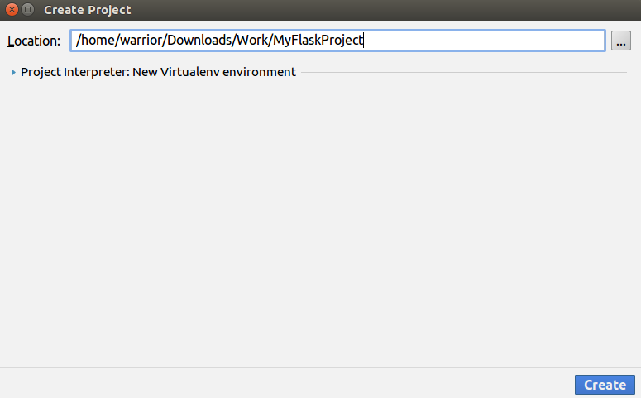
Simple API using Flask
Let’s write a simple code to print Hello<name> program using flask.
Step 1: First, let’s create a project with name “MyFlaskProject” in PyCharm.

Slide 22
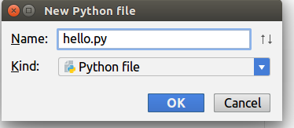
Simple API using Flask
Step 2: Create a python file inside the “MyFlaskProject”.
Right click on “MyFlaskProject” → New → Python File → Name it as “hello.py”

Slide 23
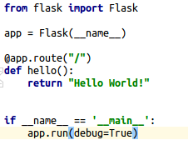
Simple API using Flask
Let’s write the code to return “Hello World!”.

Slide 24
Run the Application
To run the application you can either use the flask command or python’s -m switch with Flask.
Before you can do that you need to tell your terminal the application to work with by exporting the FLASK_APP environment variable.
Command: export FLASK_APP=hello.py
flask run

Slide 25
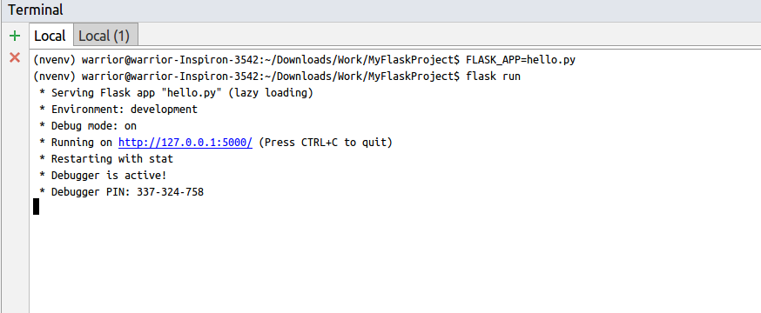
Running the Application
This launches a very simple builtin server, which is good enough for testing.

Slide 26
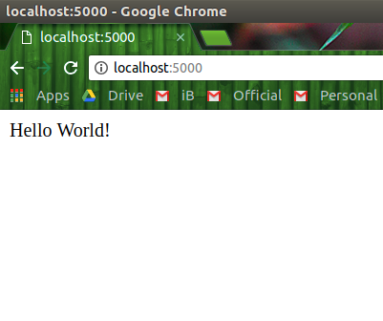
Response
Now, head over to your browser and access “http://127.0.0.1:5000” or “localhost:5000”. It will show the page with “Hello World!” message.

Slide 27
Code Explanation
Let’s take a look to the code.
from flask import Flask
This line ask the application to import Flask module from flask package. Flask used to create instances of web application.
Notes:
https://medium.com/python-pandemonium/build-simple-restful-api-with-python-and-flask-part-1-fae9ff66a706

Slide 28
Code Explanation
app = Flask(__name__)
This line create an instance of your web application. __name__ is a special variable in python, it will equal to “__main__” if the module(python file) being executed as the main program.

Slide 29
Code Explanation
@app.route("/")
This line define the routes.
For example if we set route to “/” like above, the code will be executed if we access localhost:5000/. You could set the route to “/hello” and our “hello world” will be shown if we access localhost:5000/hello.

Slide 30
Code Explanation
def hello():
return "Hello World!"
This line define function that will be executed if we access route.

Slide 31
Code Explanation
if __name__ == '__main__':
app.run(debug=True)
This line mean that your flask app will being run if we run from hello.py.
Notice also that we are setting the debug parameter to true. That will print out possible Python errors on the web page helping us trace the errors.

Slide 32
External Visible Server
If you run the server you will notice that the server is only accessible from your own computer, not from any other in the network.
This is the default because in debugging mode a user of the application can execute arbitrary Python code on your computer.

Slide 33
External Visible Server
If you have the debugger disabled or trust the users on your network, you can make the server publicly available simply by adding --host=0.0.0.0 to the command line:
flask run --host=0.0.0.0
This tells your operating system to listen on all public IPs.

Slide 34
Debug Mode
The flask script is nice to start a local development server, but you would have to restart it manually after each change to your code.
If you enable debug support the server will reload itself on code changes, and it will also provide you with a helpful debugger if things go wrong.

Slide 35
Debug Mode
To enable all development features (including debug mode) you can export the FLASK_ENV environment variable and set it to development before running the server:
export FLASK_ENV=development
flask run

Slide 36
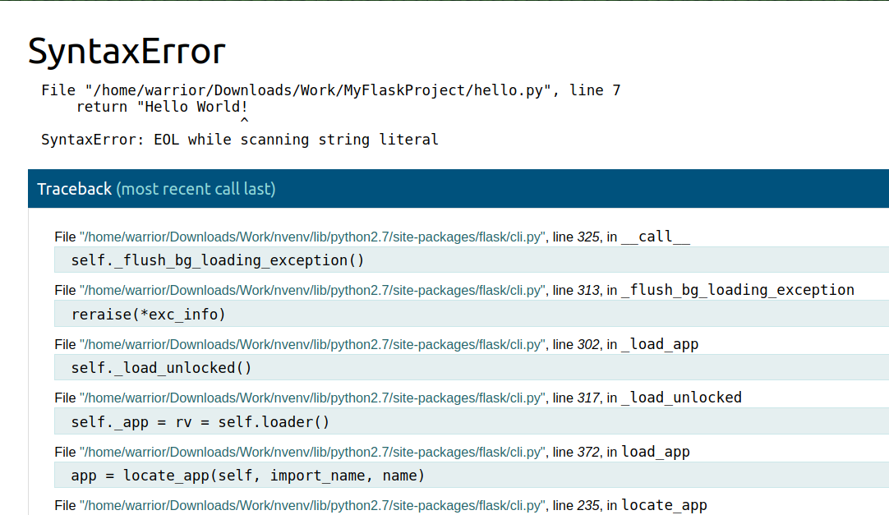
Debug Mode
Let’s make some changes to our code to check how debug mode works.

Slide 37
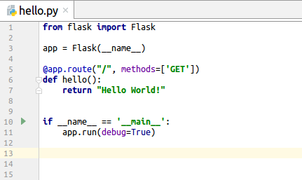
HTTP Methods
Web applications use different HTTP methods when accessing URLs.
By default, a route only answers to GET requests. We can use the methods argument of the route() decorator to handle different HTTP methods.

Slide 38
Rendering Templates
Generating HTML from within Python is not fun, and actually pretty cumbersome because you have to do the HTML escaping on your own to keep the application secure.
Because of that Flask configures the Jinja2 template engine for you automatically.

Slide 39
Rendering Templates
To render a template you can use the render_template() method.
All you have to do is provide the name of the template and the variables you want to pass to the template engine as keyword arguments.

Slide 40
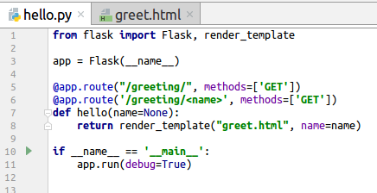
Rendering Templates
Let’s include render_template() in our hello.py code.

Slide 41
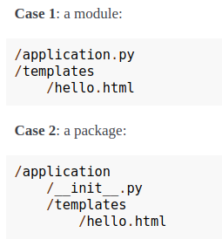
Rendering Templates - Example
Flask will look for templates in the templates folder. So if your application is a module, this folder is next to that module, if it’s a package it’s actually inside your package.

Slide 42
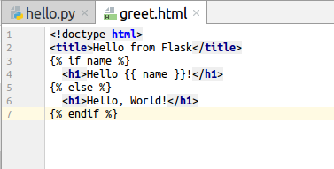
Rendering Templates - Example
For templates you can use the full power of Jinja2 templates. You can create a html file by right clicking on templates folder.
templates → right-click → New → HTML File → Name it as “greet.html”

Slide 43
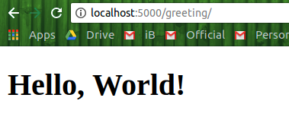
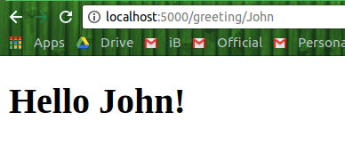
Rendering Templates - Example
Since Debug Mode is enabled, server will reload automatically.
If you close it, run the application with flask using flask run command.
Go to your browser and type URL:
“localhost:5000/greeting/John” or “127.0.0.1:5000/greeting/John”.
If we didn’t specify any name, it will display “Hello, World!”

Slide 44
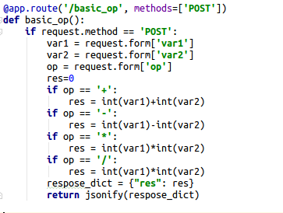
Flask - Example
Let’s make a function to perform basic arithmetic operations and return the result using POST method.
We need to import request and jsonify.
from flask import Flask, request, jsonify

Slide 45
Python Request Library
Now, let’s use python request library to make API call. First, install python requests library using command: pip install requests
Go to ipython shell by giving the command: ipython

Slide 46

Flask - Example
In shell, type
import requests
r = requests.post('http://127.0.0.1:5000/basic_op', data={'var1':'1', 'var2':'2', 'op':'*'})

Slide 47
Flask
To learn more about Flask, you can refer it’s documentation.
Ref: http://flask.pocoo.org/docs/1.0/

Slide 48
Flask-SQLAlchemy
Flask-SQLAlchemy is an extension for Flask that adds support for SQLAlchemy to your application.
It requires SQLAlchemy 0.8 or higher.
It aims to simplify using SQLAlchemy with Flask by providing useful defaults and extra helpers that make it easier to accomplish common tasks.

Slide 49
SQLAlchemy
SQLAlchemy is the Python SQL toolkit and Object Relational Mapper that gives application developers the full power and flexibility of SQL.
It provides a full suite of well known enterprise-level persistence patterns, designed for efficient and high-performing database access, adapted into a simple and Pythonic domain language.
Notes:
http://www.sqlalchemy.org/

Slide 50
Flask-SQLAlchemy
For the common case of having one Flask application all you have to do is to create your Flask application, load the configuration of choice and then create the SQLAlchemy object by passing it the application.

Slide 51
Flask-SQLAlchemy
Once created, that object then contains all the functions and helpers from both sqlalchemy and sqlalchemy.orm.
Furthermore it provides a class called Model that is a declarative base which can be used to declare models.

Slide 52
Installation
Command to install Flask-SQLAlchemy extension:
pip install flask-sqlalchemy
Let’s create a sample fb_replica project to understand Flask-SQLAlchemy better.

Slide 53
Sample Project
In FbReplica post, let’s keep three APIs.
Inserte Post
Get Post
Update Post
Show All Posts

Slide 54
Flask-SQLAlchemy
Step 1: Create a folder with name “fb_replica” in PyCharm and inside the folder, create a python file with name “facebook_post.py”.
Inside the facebook_post.py, import Flask, SQLAlchemy, and jsonify.
Code:
from flask import Flask, request
from flask_sqlalchemy import SQLAlchemy
from flask import jsonify

Slide 55

Flask-SQLAlchemy
Step 2: Flask-SQLAlchemy loads these values from the main Flask config which can be populated in various ways.
Basic configurations that are required for now are:
app.config['SQLALCHEMY_DATABASE_URI'] = 'sqlite:///FbPosts.sqlite3': The database URI that should be used for the connection.
db = SQLAlchemy(app): Binding the instance to a very specific application.
Notes:
http://flask-sqlalchemy.pocoo.org/2.3/api/

Slide 56
Flask-SQLAlchemy
Step 3: Create a model FbPosts with details id, username and post and save in the “facebook_post.py” file which we created prior.
class FbPosts(db.Model):
id = db.Column(db.Integer, primary_key=True)
username = db.Column(db.String(100))
user_post = db.Column(db.String(200))

Slide 57
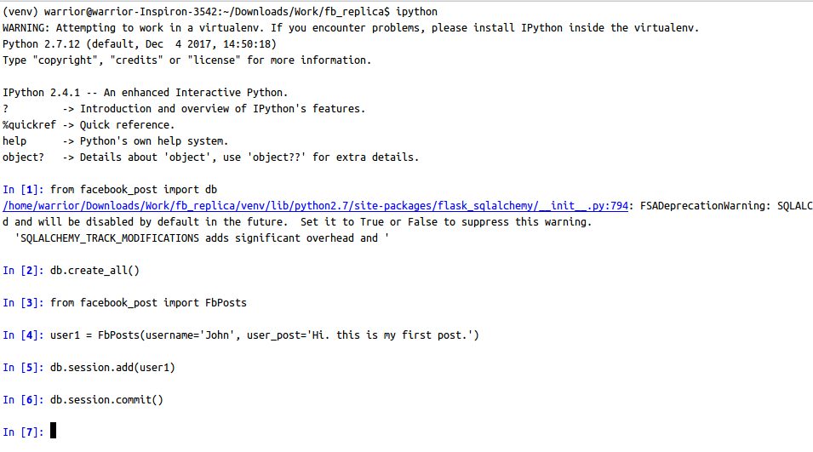
Flask-SQLAlchemy
Step 4: To create the initial database, first import the db object from an interactive Python shell.
Command to get interactive python shell: ipython
Command to import db object: from facebook_post import db

Slide 58
Flask-SQLAlchemy
Step 5: And run the SQLAlchemy.create_all() method to create the tables and database.
Your database is created.
Let’s create some users and their posts.

Slide 59
Database Migrations
Flask-Migrate is an extension that handles SQLAlchemy database migrations for Flask applications using Alembic.
The database operations are made available through the Flask command-line interface or through the Flask-Script extension.
Notes:
https://flask-migrate.readthedocs.io/en/latest/

Slide 60
Session object
The Session object of SQLAlchemy manages all persistence operations of ORM object.
Object-relational mapping (ORM, O/RM, and O/R mapping tool) is a programming technique for converting data between incompatible type systems using object-oriented programming languages.

Slide 61
Session object
The following session methods perform insert, delete, and retrieve operations −
db.session.add(model object) − inserts a record into mapped table
db.session.delete(model object) − deletes record from table
model.query.all() − retrieves all records from table

Slide 62
Flask-SQLAlchemy
Step 6: Creating users and their posts.
Command: from facebook_post import FbPosts
user1 = FbPosts(username='John', user_post='Hi. this is my first post.')
db.session.add(user1)
db.session.commit()

Slide 63
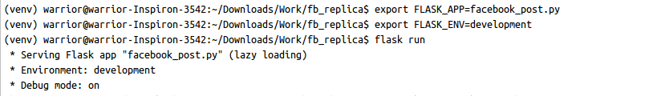
Flask Run
Step 7: Export the values FLASK_APP and FLASK_ENV.
Commands:
EXPORT FLASK_APP=facebook_post.py
EXPORT FLASK_ENV=development
flask run

Slide 64
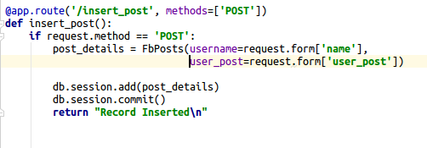
Insert Post
Step 8: Let’s write a function to insert post into database.
Parameters: name, user_post
Code:

Slide 65
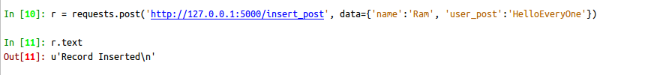
Request using Python Request Library
Let’s use Python Request Library to make API call to insert_post.
Import requests using command: import requests
Command: r = requests.post('http://127.0.0.1:5000/insert_post', data={'name':'Ram', 'user_post':'HelloEveryOne'})

Slide 66
Request using CURL
Let’s use CURL to make API call to insert_post.
Command: curl --request POST --data "name=Gita&user_post=I am Gita" http://127.0.0.1:5000/insert_post

Slide 67
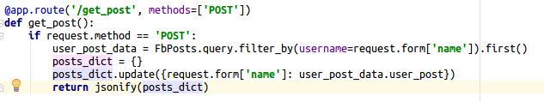
Get Post
Let’s create get_post function to get posts related to specific user.
Parameters: name

Slide 68

Using Python Request Library
Let’s use Python Request Library to make API call to get_post.
Command: r = requests.post('http://127.0.0.1:5000/get_post', data={'name':'Ram'}

Slide 69

Using CURL
Let’s use CURL to make API call to get_post.
Command: curl --request POST --data "name=Sita" http://127.0.0.1:5000/get_post

Slide 70
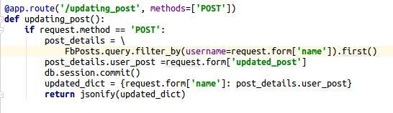
Update Post
Let’s create updating_post function to update the post of a user.
Parameters: name, updated_post

Slide 71

Using Python Request Library
Make API call using Python Request Library.
Type:
r = requests.post('http://127.0.0.1:5000/updating_post', data={'name':'Sita', 'updated_post':'IAmSita'})

Slide 72
Using CURL
Make API call to update post using CURL.
Type:
curl --request POST --data "name=Sita&updated_post=This is my post" http://127.0.0.1:5000/updating_post

Slide 73
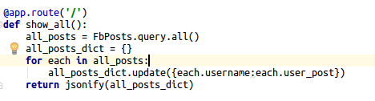
Show All Posts
Let’s create show_all function to display all the posts.

Slide 74
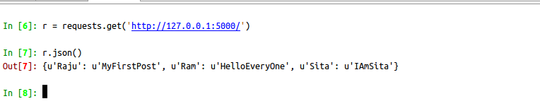
Show All Posts
Make API call using Python Request Library.
Type: r = requests.get(‘http://127.0.0.1:5000/’)

Slide 75
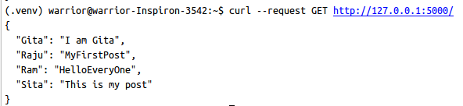
Request Using CURL
Make API call using CURL.
Command: curl --request GET http://127.0.0.1:5000/

Slide 76
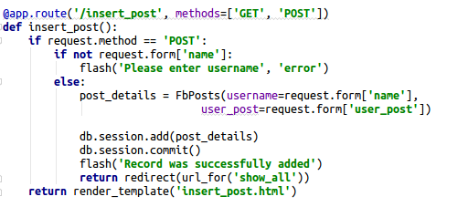
Inserting Post
In flask, we can set the template and test the API by sending request from web page.
As we have discussed earlier about render_template method, let’s add it to the code to render a template.
HTML file name: insert_post.html

Slide 77
Inserting Post
We have to import render_template, redirect, url_for, and flash from flask.
Import statements:
from flask import Flask, request, flash, url_for, redirect, render_template
from flask_sqlalchemy import SQLAlchemy

Slide 78

Display all posts
Once the post is inserted, let’s make an API connect with a HTML script to show all posts.
FbPosts.query.all() method will retrieve all posts from FbPosts database.
Function name: show_all()

Slide 79
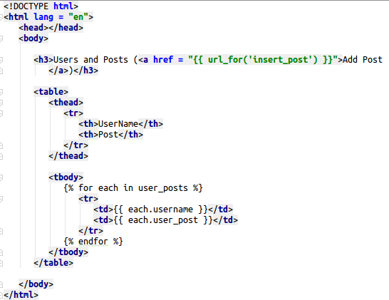
Displaying all Posts
File name for HTML code is: show_all.html

Slide 80
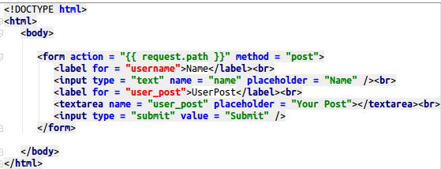
Insert Post
Let’s create a HTML page to enter username and Post. The HTML script of the template (‘insert_post.html’) is

Slide 81
Run App using Flask
Run the flask by typing flask run command. First, export FLASK_APP=facebook_post.py and FLASK_ENV=development.
Commands: export FLASK_APP=facebook_post.py
export FLASK_ENV=development
flask run

Slide 82
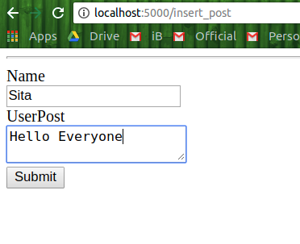
Inserting Post
Open the browser and go to URL: “127.0.0.1:5000/insert_post” or “localhost:5000/insert_post” and enter name, post and click submit.

Slide 83
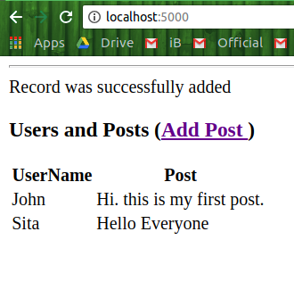
Displaying all Posts
Once you enter the post, name and click Submit, it will show all the posts entered till now.

Slide 84
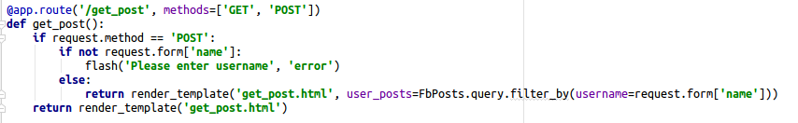
Get Posts
Let’s see how to get posts of specific user.
Function name: get_post
It will filter the posts based on username and displays their posts.
Let’s write HTML code to see the basic view.

Slide 85
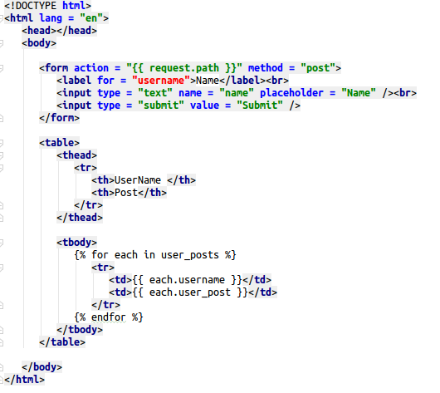
Get Posts
The HTML script of the template (‘get_post.html’):
It will take the data from get_post function and displays in the web page.

Slide 86
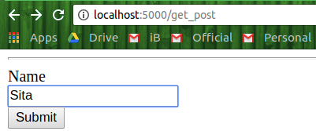
Get Posts
Now, go to your browser and type “localhost:5000/get_post” or “127.0.0.1:5000/get_post”.
Enter any existed name. For example, Sita and click Submit.

Slide 87
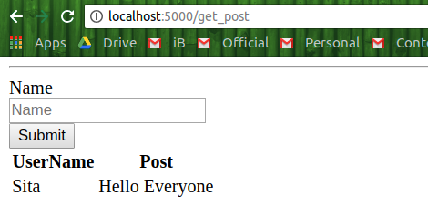
Get Posts
It will display all posts by Sita.

Slide 88
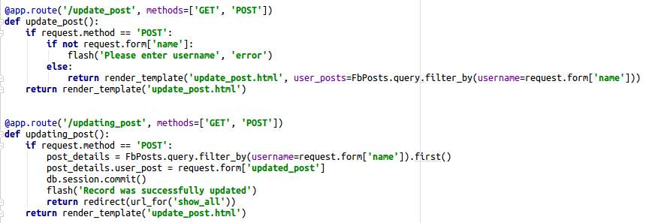
Updating Post
Function name for update_post: update_post

Slide 89
Updating Post
Function name for update_post: updating_post
When user clicks Submit, the updating process will be processed with updating_post function.

Slide 90
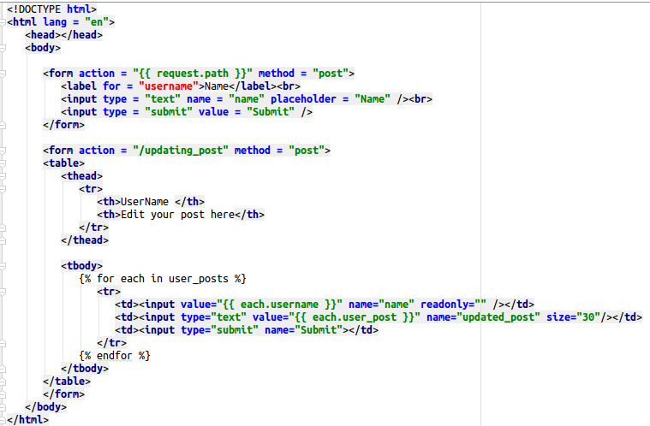
Updating Post
Name of the HTML script:
update_post.html
HTML script to show the interface:

Slide 91
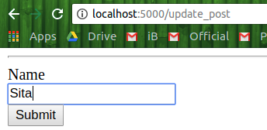
Updating Post
For example, let’s enter Name:Sita and click Submit.

Slide 92
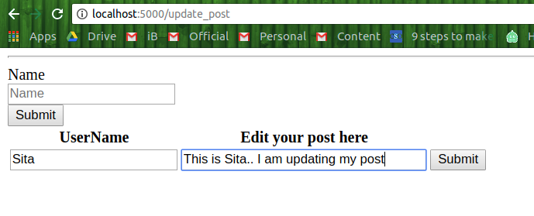
Updating Post
Here, in the text field showed below “Edit your post here”, you can edit the post.
Let’s edit the post and check.

Slide 93
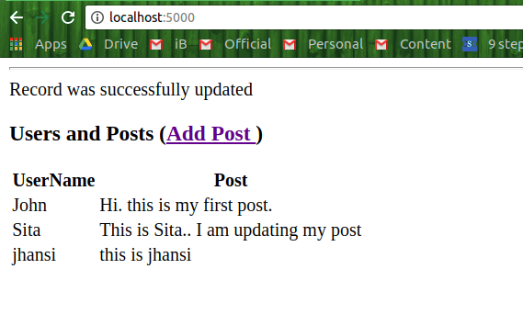
Updating Post
Here, we can observe that Sita’s post is updated in the database.

Slide 94
END

